Slide 1

Mahavir Education Trust’s Shah & Anchor Kutchhi Engineering College, Chembur, Mumbai 400 088 UG Program in Electronics Engineering
Ingenious Security Assistance for COVID-19.
Group member:
Debanik Kundu BE1-22 Siddhesh Palekar BE1-23 Rishab Shetty BE1-24 Abhishek Tapole BE1-29
Under the Guidance of : Prof. Anita S. Nalawade

Slide 2
OVERVIEW
INTRODUCTION
PROBLEM STATEMENT
PROJECT OBJECTIVE
WORK FLOW AND BLOCK DIAGRAM
HARDWARE IMPLEMENTATION
FLOWCHART
SOFTWARE IMPLEMENTATION
PROJECT OUTPUT AND ESTIMATED COST
FUTURE SCOPE AND SUMMARY

Slide 3
INTRODUCTION
Due to increase of COVID-19 cases in India, it is a need of the hour for such devices to be installed in our society for monitoring.
To eradicate COVID-19 virus important factor is preventing the spread of virus in our locality, taking precaution based on the advisories being issued by ministry of health and family welfare.
The project we had implemented, is a portable and user-friendly low power consuming product.
We designed this product in such a way that the whole process is completely contactless, to keep it safe for the society.

Slide 4
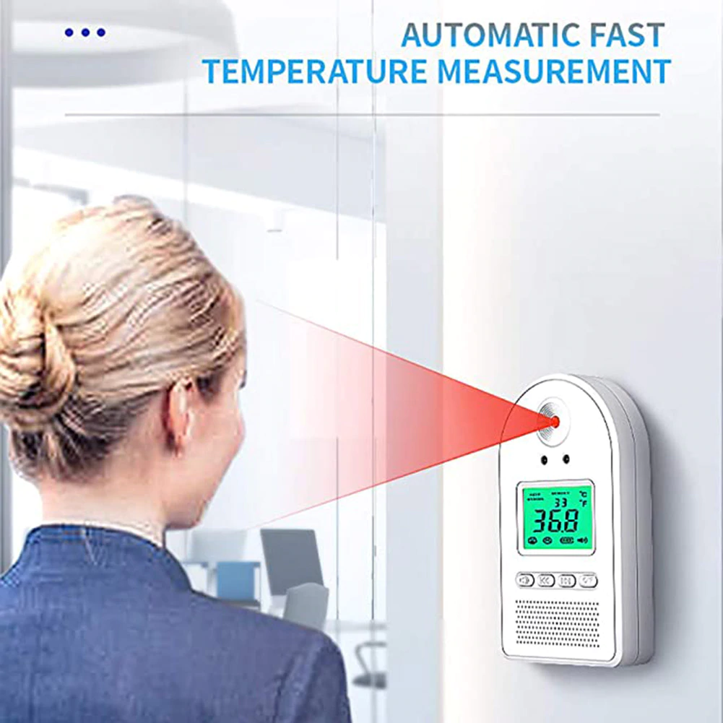
PROBLEM STATEMENT
Automation of Society Security Tasks – Visitors in a housing society fall in the category of regular visitors like drivers, maids, milkman, sweeper, car cleaners, etc who visit on a daily basis and the other category is of infrequent known or unknown visitors ( like guests, delivery boys).

Slide 5
PROJECT OBJECTIVE
To Develop a fully contactless security system to prevent the increase of covid 19 virus.
To increase the traceability of the potential carrier or spreader.
To increase the security of society using modern technology.

Slide 6
WORKFLOW
RESEARCH DIFFERENT PAPERS AND WEBSITES TO SET DIRECTION OF OUR PROJECT
INTERFACING HARDWARE UNITS WITH RASPBERRY-PI 3
BEGIN WITH DISTANCE AND TEMPERATURE MEASUREMENT
FORWARD TO FACE RECOGNITION AND UPDATION OF DATABASE SERVER
IMPLEMENT WEBSITE FOR EASY VISUALS OF RECORDED DATA
CONNECT HARDWARE & SOFTWARE TOGETHER TO CHECK FINAL WORKING

Slide 7
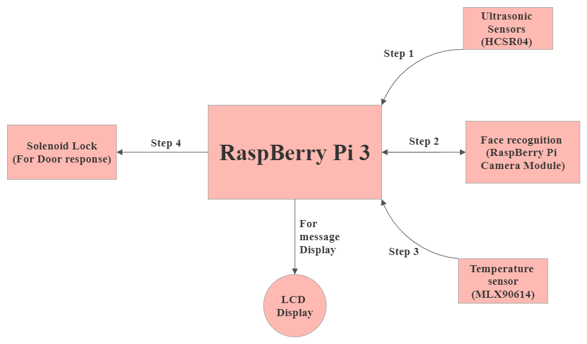
Block Diagram

Slide 8
1. HARDWARE REQUIREMENTS. 2. INTERFACING WITH RASPBERRY-PI 3.
HARDWARE IMPLEMENTATION

Slide 9
HARDWARE REQUIREMENTS
Ultrasonic Sensor -1.
Raspberry Pi 3.
Raspberry Pi Camera Module.
Solenoid Lock -1.
Relay-1.
MLX90614 Infrared Thermometer-1.
LCD Display-1.
LEDs .
Buzzer.

Slide 10

RASPBERRY PI 3 B+
CPU | Quad Cortex A53 @ 1.2 Ghz
Instruction Set | ARMv8-A
GPU | 400 MHz VideoCore IV
RAM | 1 GB SDRAM
Storage | Micro-sd (16 GB)
Ethernet | 10/100
Wireless | 802.11n / Bluetooth 4.0
Video Output | HDMI / Composite
Audio Output | HDMI / Headphone
GPIO | 40

Slide 11
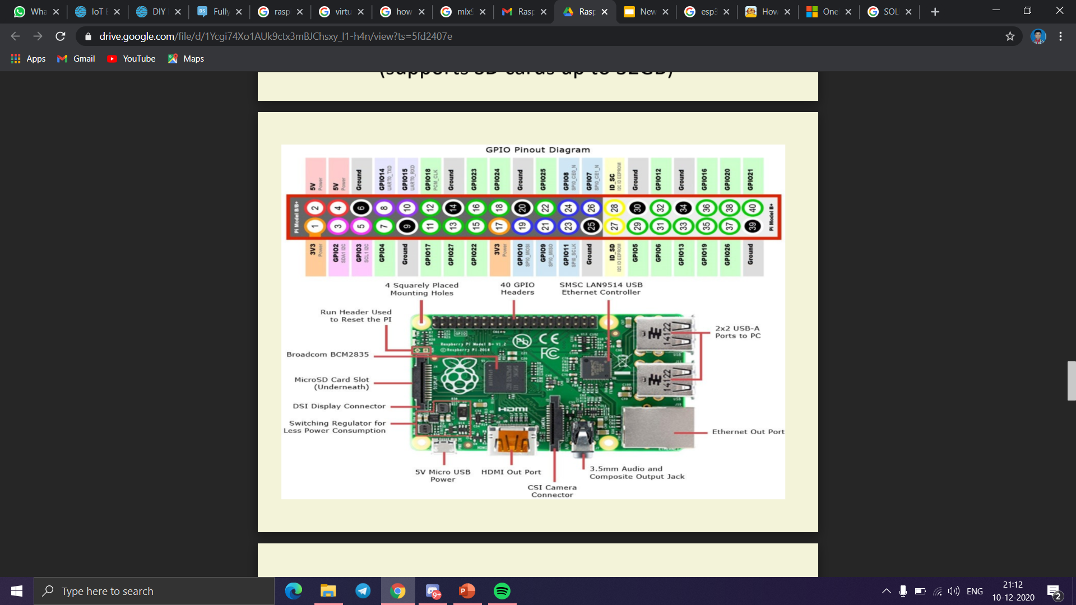

Slide 12
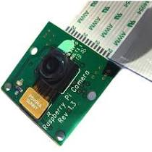
RASPBERRY PI CAMERA MODULE
Still Resolution | 5 megapixel
Video Mode | 1080p30, 720p60 and 640 × 480p60/90
Sensor | OmniVision OV5647
Sensor Resolution | 2592 × 1944 pixels
Sensor Image Area | 3.76 × 2.74 mm
Pixel Size | 1.4 µm × 1.4 µm
Optical Size | 1/4"
Dynamic Range | 67 dB @ 8x gain
Sensitivity | 680 mV/lux-sec

Slide 13
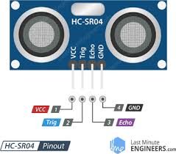
ULTRASONIC SENSOR(HCSR04)
Power supply | 5v
Range | 2 cm - 400 cm
Effectual angle | <15 degree

Slide 14
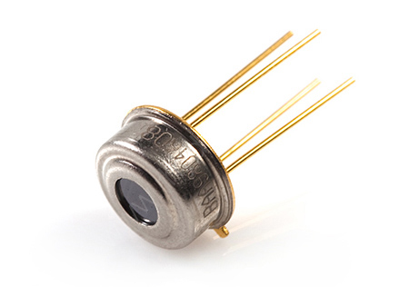
MLX90614 INFRARED THERMOMETER
Small size, low cost
Easy to integrate
Factory calibrated in wide temperature range:
-40 to +85°C for sensor temperature
-70 to +380°C for object temperature
SMBus compatible digital interface
Customizable PWM output for continuous reading
High accuracy of 0.5°C over wide temperature range (0 to +50°C for both Ta and To)
Measurement resolution of 0.02°C
Simple adaptation for 8 to 16V applications
Power saving mode
Automotive grade

Slide 15
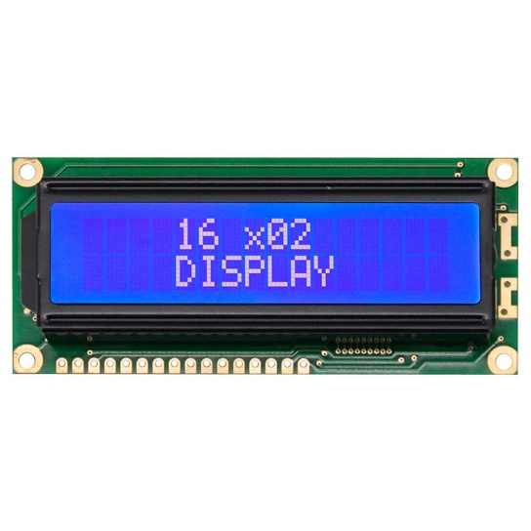
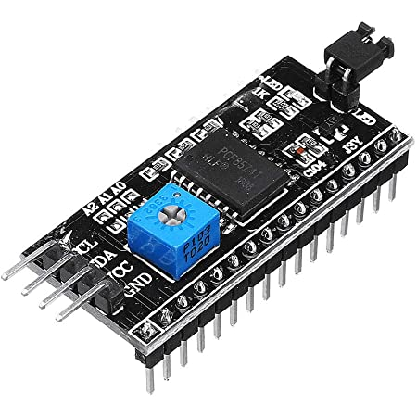
LCD DISPLAY
Operating Voltage | 4.7-5.3 V
Current Utilization | 1mA
Display Characters | Alphanumeric and custom generated characters
Characters Dimensions | 5*8 pixel
Number of modes | 2 (4-bit & 8-bit)
Backlight | Blue
LCD display dimensions are 16*2.
We used I2C module, which is a easy to build display module, makes easy connections for LCD.

Slide 16
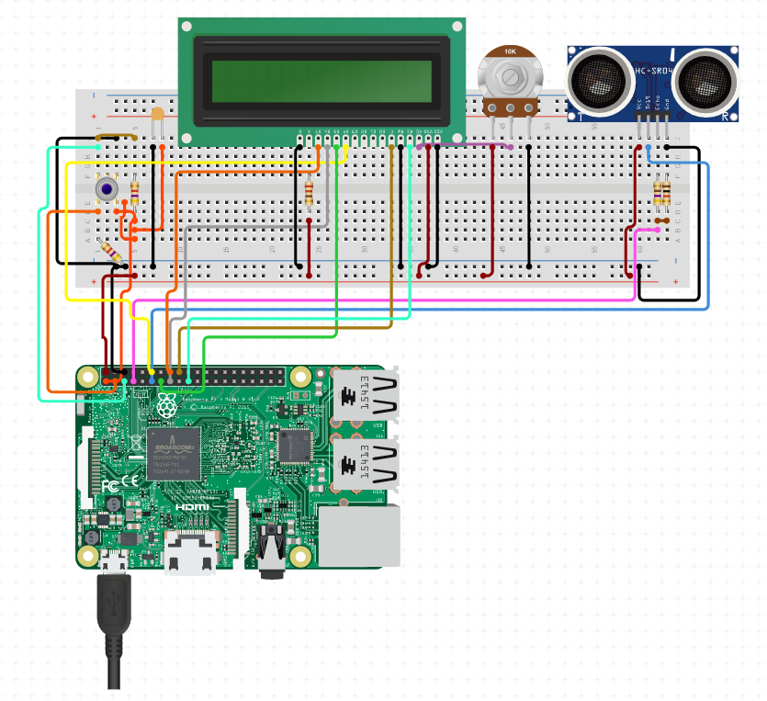
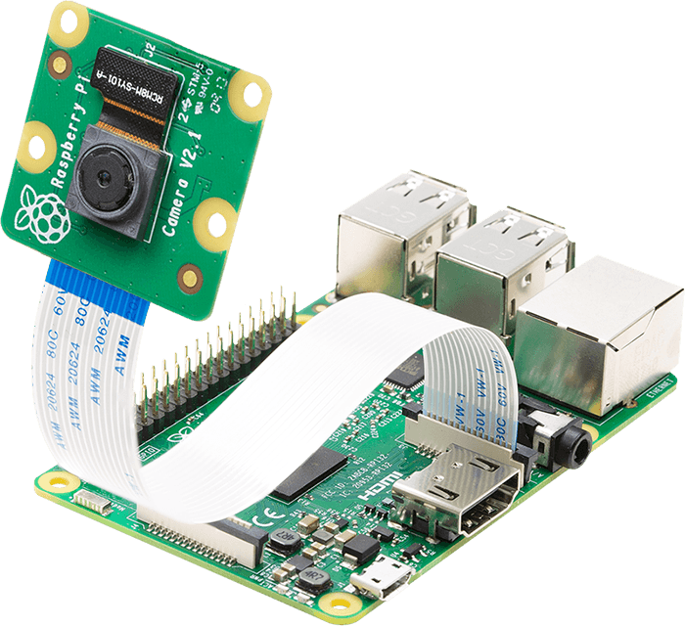
HARDWARE IMPLEMENTATION

Slide 17
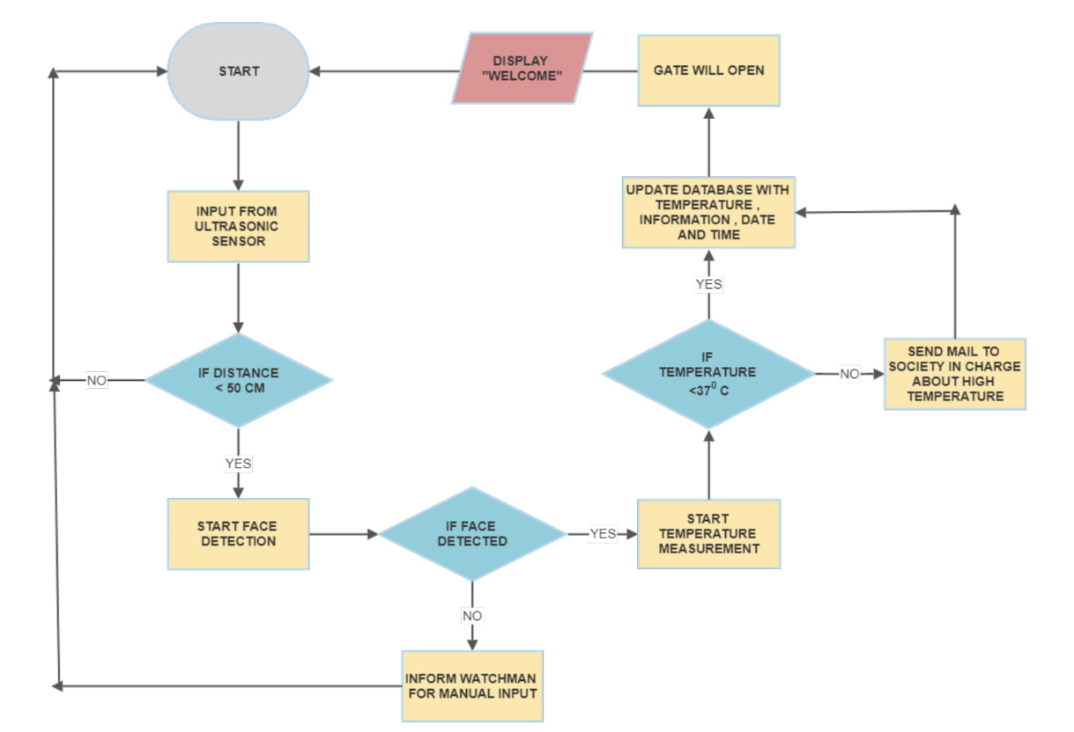
FLOW-CHART OF PROJECT

Slide 18
SOFTWARE IMPLEMENTATION
FACE RECOGNITION
MAIL ALERTS TO AUTHORITIES USING SMTP PROTOCOL
MAINTAINANCE OF DATABASE WITH SQlite

Slide 19
SOFTWARE IMPLEMENTATION OF PROJECT
We have disintegrate the software part into three parts, i.e. mail alerts to the authorities, Face recognition and the maintenance of the database for the records.
The mail alerts will let the authorities know about if someone with high temperature appear near the security system check, more details will be shared to you in further slides.
Along with that we will be capturing the face of the person, who appeared at the security system, and thus will be uploaded in database, and for that we will be using face recognition for the same cause.
Lastly, all this will be uploaded into the database for information gathering and keeping a records.

Slide 20
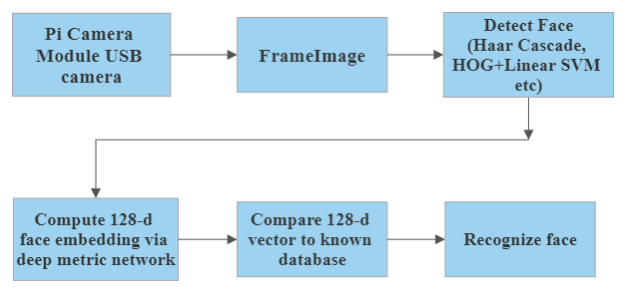
FACE RECOGNITION
Library – OpenCv2- A library of Python bindings designed to solve computer vision problems

Slide 21
E-MAIL ALERTS TO THE AUTHORITIES
We are going to use the SMTP for sending the mails alerts to authorities. SMTP is a set of communications guidelines that allow software to transmit ana electronics mail over the internet is called Simple Mail Transfer Protocol.
It is a program used for sending messages to other computer users based on e-mail addresses
It provide a mail exchange between users on the same or different computers, and it also requires support:
1. It can send a signal message to one or more recipients.
2. Sending message can include text, voice, video or graphics.
3. It can also send the messages on networks outside the internet.

Slide 22
DATABASE
SQLite is a software library that provides relational database management system. The lite in SQLite means lightweight in terms of setup, database administration, and required resources.
SQLite has the following noticeable features:
Serverless
Self-Contained
Zero-Configuration
We will be making a REST API for our database using Django’s(Python web framework) rest framework.

Slide 23
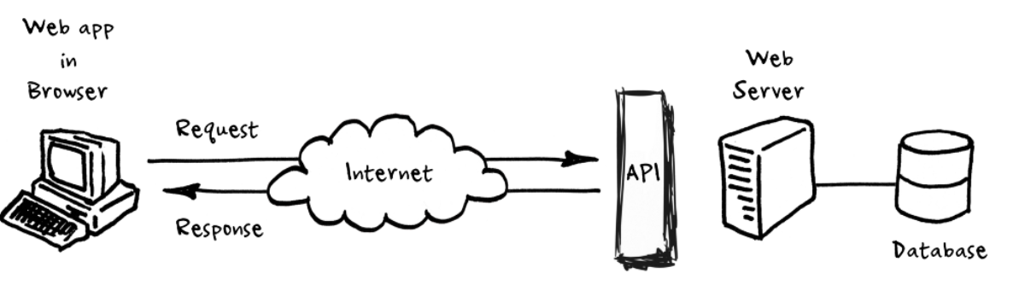
What is an API?
API stands for Application Programming Interface, its request to retrieve or write data are generally done by sending HTTP response to server.

Slide 24
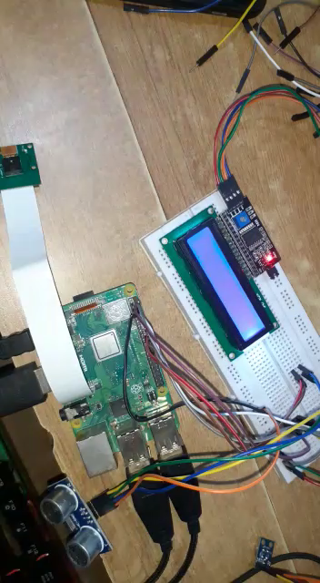
BASIC SYSTEM WORK FLOW AND DISPLAY

Slide 25
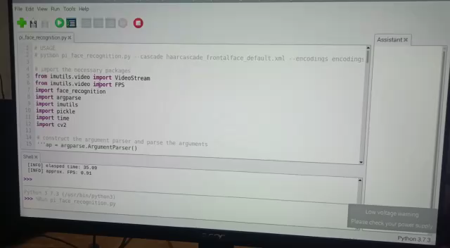
FACE RECOGNITION

Slide 26
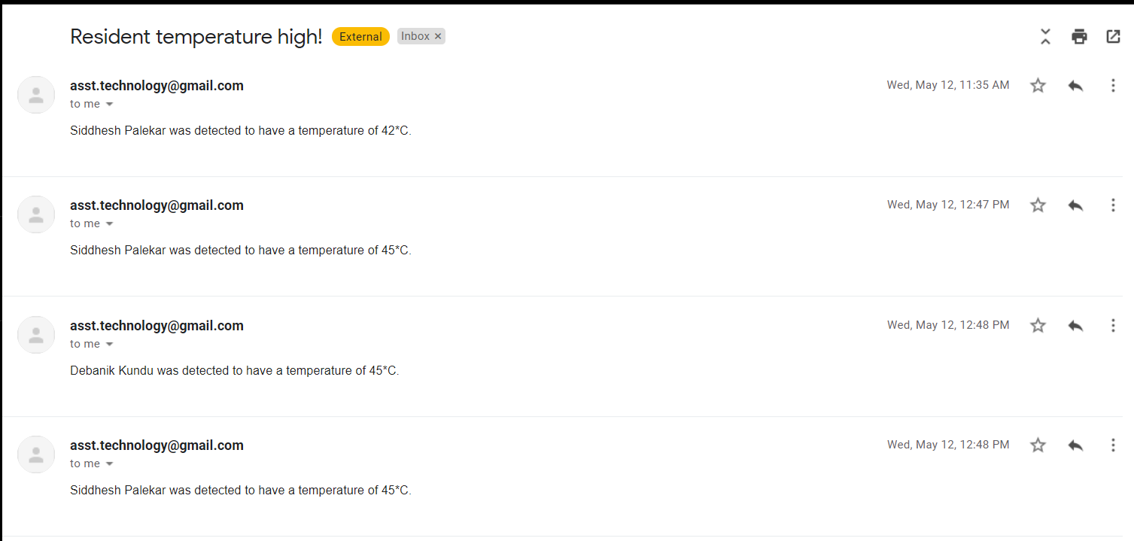
E-MAIL ALERTS SENT TO ADMIN

Slide 27
ESTIMATED COST

Slide 28
FUTURE SCOPES OF THE PROJECT
There are some ideas that we would like to implement in future for better user experience with development of real world scenarios by keeping security as utmost priority. The following ideas could be tested for future extension of project:
We can keep a record of entry/exit of a car from the society, basically this implementation was done manually, but we would use RFID and barcode for this implementation.
Inside the society/industries to get real-time movement/object detection of person at particular time interval to keep the area safe, this can be implemented in some very important or protected areas.
For above implementation we need some alert making system for notifying the person in-charge, for that we can create a separate dashboard on our web-application for alerts of any suspicious movement or activity.

Slide 29
SUMMARY
The project will not only help us keep temperature records of the society members and non members, but it will also help us in keeping the society secure by not allowing any non members having high temperature.
Thus , with the use of basic sensors and sophisticated pocket size computer (Raspberry pi) a cheap and compact device for security purpose is possible. Since we are using face recognition for access control , the process will be contactless which will help us to reduce the spread of covid.

Slide 30
REFERENCES
https://create.arduino.cc/projecthub/whitebank/temperature-measuring-automatic-and-voice-inform-4d6acf
https://www.lamasatech.com/products/interactive-kiosks/body-temperature-kiosk/
https://www.circuito.io/app?components=512,11021
https://circuitdigest.com/microcontroller-projects/iot-based-contactless-body-temperature-monitoring-using-raspberry-pi-with-camera-and-email-alert
https://circuitdigest.com/microcontroller-projects/ir-thermometer-using-arduino-and-ir-temperature-sensor
https://www.pyimagesearch.com/2018/06/25/raspberry-pi-face-recognition/

Slide 31
7. .https://circuitdigest.com/microcontroller-projects/visitor- monitoring-with-raspberry-pi-and-pi-camera 8. https://youtu.be/PmZ29Vta7Vc 9. https://www.raspberrypi.org/documentation/hardware/camera/ 10. https://mygate.com/security-management

Slide 32
Thank you

